Slide 1


Dan Trevino
BLOCKSTACK

Slide 2

WHAT WILL EMERGE FROM THE CURRENT MANIA?
з
BITCOIN (DUH)
BLOCKSTACK!

Slide 3



Founded as “Onename” in 2014
HISTORY OF BLOCKSTACK
An identity system based on Namecoin
WHY DOES THIS MATTER?
Because Blockstack’s original innovation is in naming

Slide 4
ZOOKO’S TRIANGLE: PICK TWO!
DECENTRALIZED
SECURE
HUMAN- MEANINGFUL

Slide 5



ZOOKO’S TRIANGLE: EXAMPLES
Twitter is human meaningful and secure (unique), but not decentralized
Public/private (i.e. Bitcoin addresses) key pairs are decentralized and secure, but not human meaningful
Decentralized and human meaningful…no one does this. But conceptually, it’s easy to make an insecure (not unique) name if there is no central authority and no way of ensuring consensus

Slide 6



BUSTING ZOOKO’S TRIANGLE
WITH BLOCKCHAINS WE CAN BREAK ZOOKO’S TRIANGLE
The blockchain provides a single source of truth where you register names and store the hash of their value
Blockstack uses the Bitcoin blockchain to build a replacement for the Domain Name System: The Blockchain Name System (BNS)
The BNS replaces the DNS root servers (a trusted third party) with a blockchain based system

Slide 7


BENEFITS OF BNS
NO MORE SURVEILLANCE!
Enables
Decentralized
MORE
SECURE
Serverless
Applications

Slide 8
TECHNICAL DETAILS
But note that: Blockstack can be migrated if the underlying blockchain becomes insecure, because they reconstruct consensus using virtualchains (created via your Blockstack full node).
…ARE COMPLICATED. READ THE WHITEPAPER!
The network successfully migrated off of Namecoin

Slide 9
Alright, we have a new DNS. What next?
1
Follow this to its logical conclusion: decentralized storage
2
A Blockstack principle is that users, not corporations, etc., should own their own data
HOW DO WE ACCOMPLISH THIS?

Slide 10



ENTER “GAIA”
Uses storage providers like Amazon S3, Dropbox and Google Drive as “dumb drives”
Users store encrypted/signed data on their own Dropbox (or whatever) account
This way, get the performance benefits of S3, but all they see is an encrypted blob

Slide 11

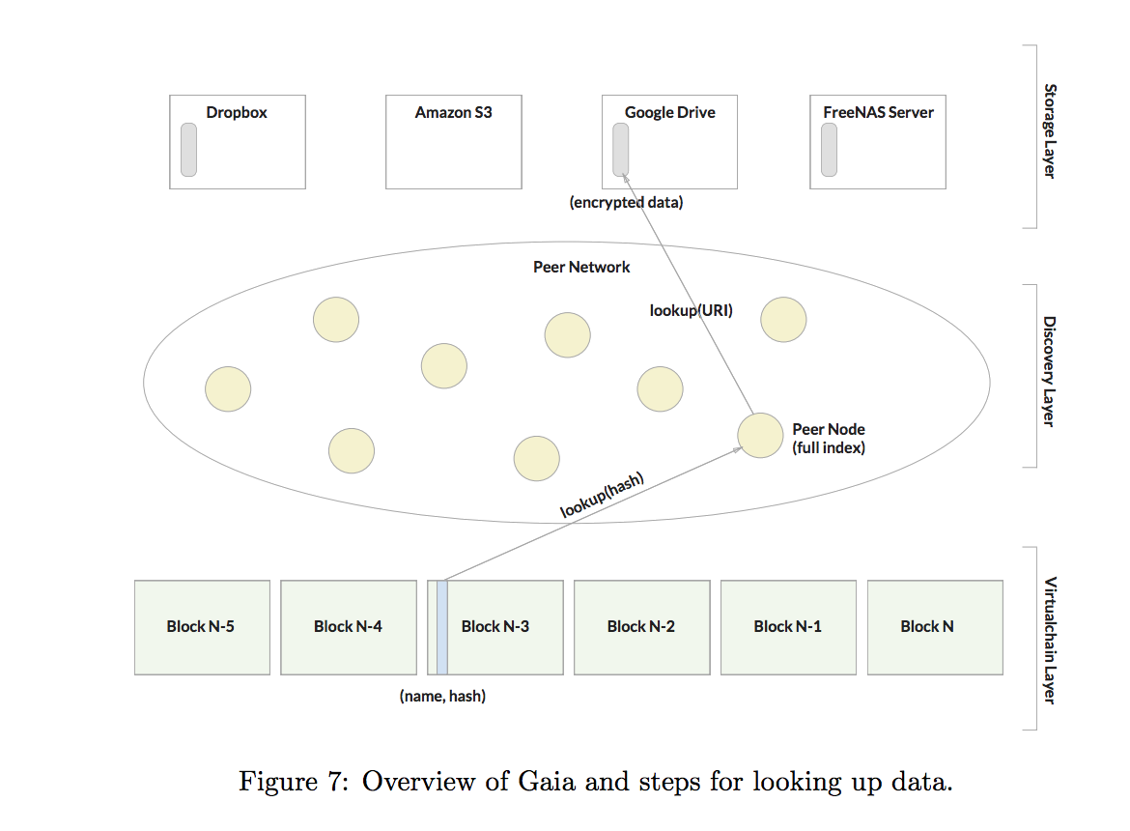
DIAGRAM 2:
DIAGRAM RELOADED

Slide 12


PRACTICAL IMPLICATIONS: SCALABILITY
ONLY STORE WHAT’S NECESSARY
Blockstack is a very light approach to dApps and the blockchain.
As a result, scaling prospects are bright

Slide 13

USING BLOCKSTACK
REMOVES SERVERS FROM THE EQUATION
Blockstack.js provides simple APIs for auth, storage, and (soon) payments
Enabling simple creation of decentralized apps

Slide 14


THE BLOCKSTACK
TOKEN: STACKS
THIS IS ITS OWN WHITE PAPER… BUT HERE ARE THE HIGHLIGHTS!
Blockstack recently raised ~50 million USD in a token sale, with the potential for another 50 million
What is the utility beyond fund raising?

Slide 15


STACKS
GOVERNANCE (STACKHOLDER?) VOTING
INCENTIVE FOR DEVELOPERS TO BUILD
Eliminates reliance on Bitcoin, which may be going a digital gold route (scaling unclear); allows Blockstack to migrate blockchains if necessary
STACKS ENABLE LIGHT CLIENTS
NAMESPACE OPERATIONS

Slide 16




FINAL THOUGHTS: BLOCKSTACK’S
APPROACH TO GROWTH
Token used to incentivize adoption and growth
Interesting to contrast Blockstack vs. Ethereum growth strategies; ICOs vs. VC and SAFT
The Blockstack Public Benefit Corporation will drive adoption of the platform
Get involved: Bounties, Pull Requests, and the Blockstack Lisboa Meetup! :)

Slide 17
Learn More!.
forum.blockstack.org
@Blockstack
github.com/blockstack
meetups
Thanks to Dan Healy for the original version of this presentation

